Slide 1
Beldo’s Holiday Book..
Compiled By: ME!

Slide 2
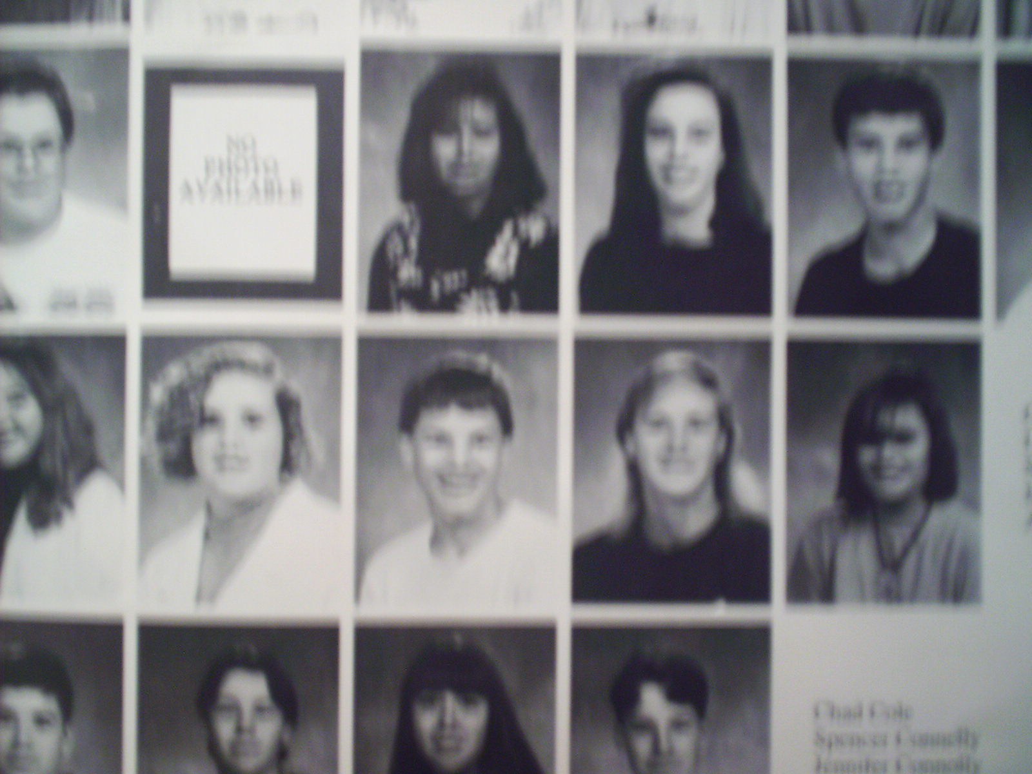
Beldo At School Before the Holidays. Where is he?
Here he is!

Slide 3
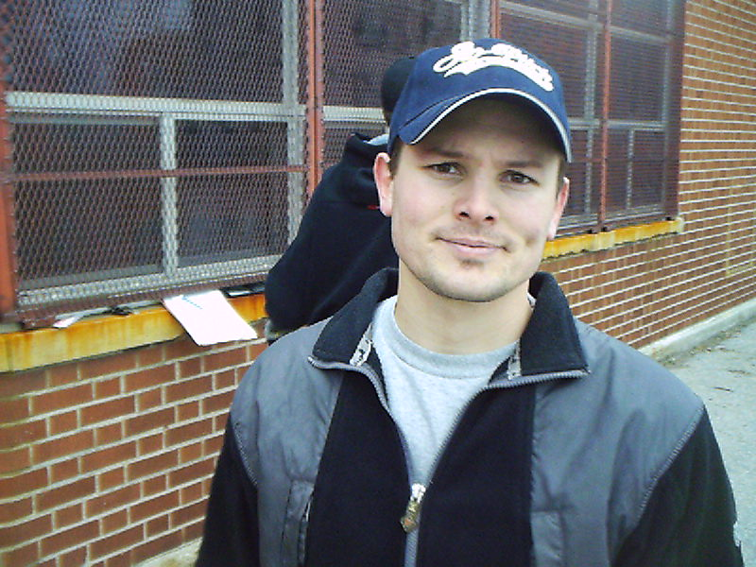
This is Beldo…
Isn’t He Cute??

Slide 4
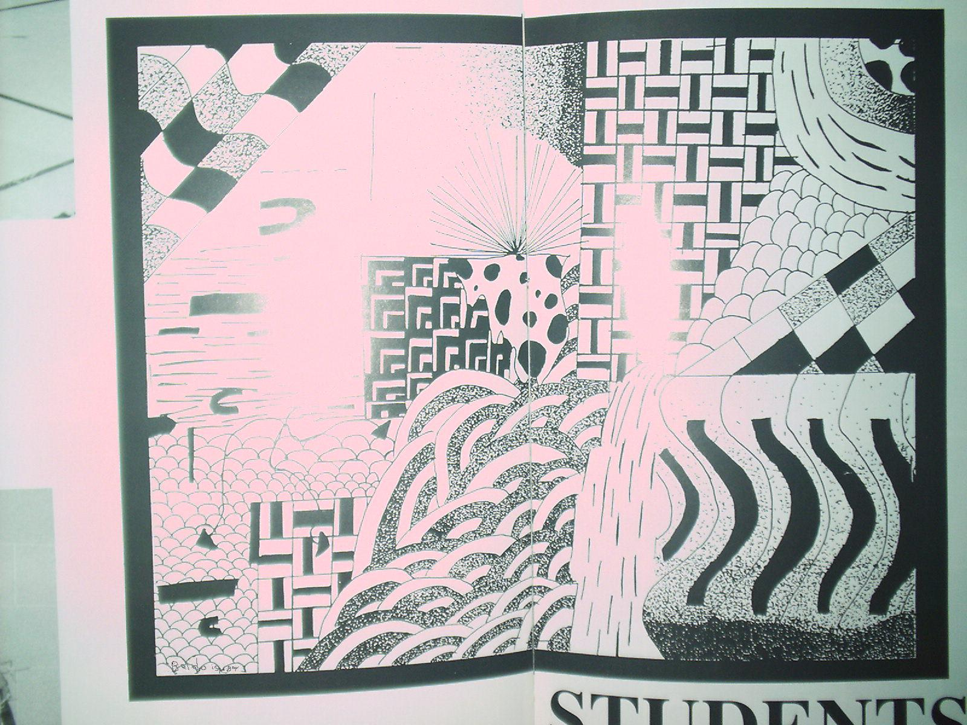
Beldo’s Artwork
Isn’t it GAY?

Slide 5
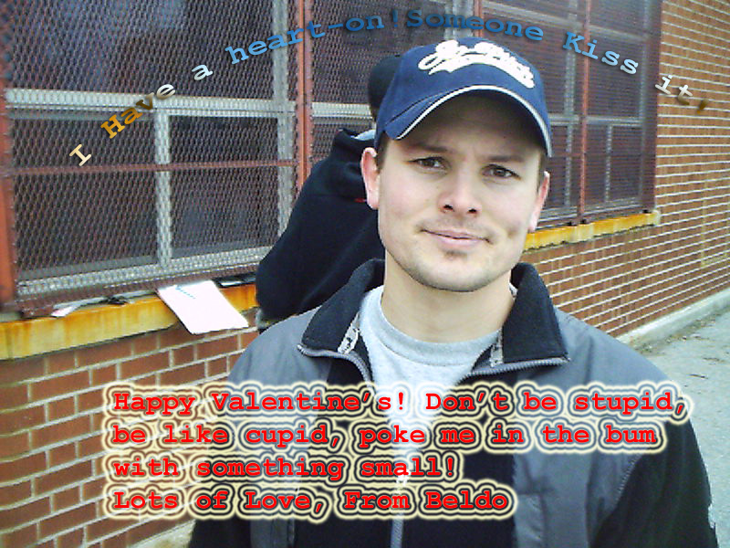
Beldo, the romancer

Slide 6
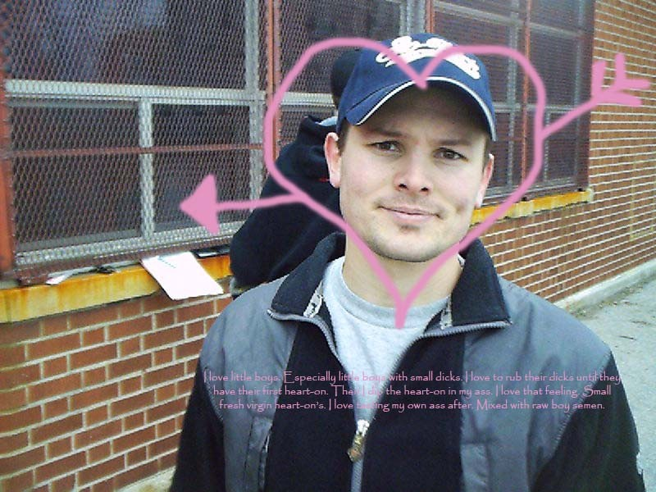
Valentines Pt. 2

Slide 7
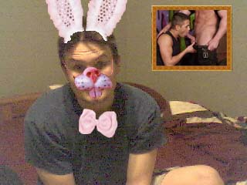
Beldo’s Easter Day!

Slide 8
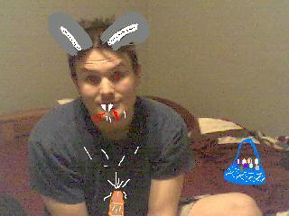

Beldo At Easter!!

Slide 9
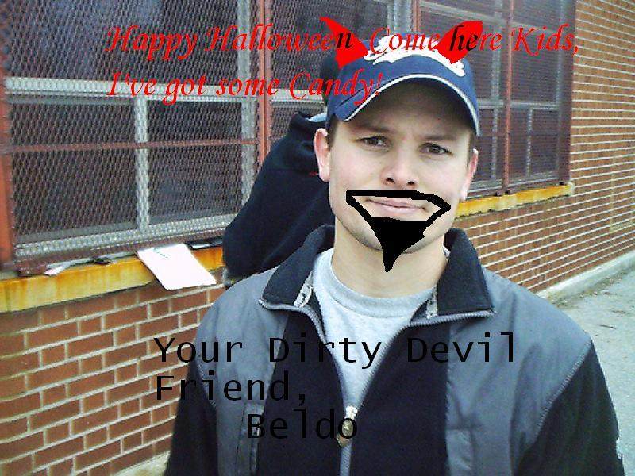
Beldo as Satan

Slide 10
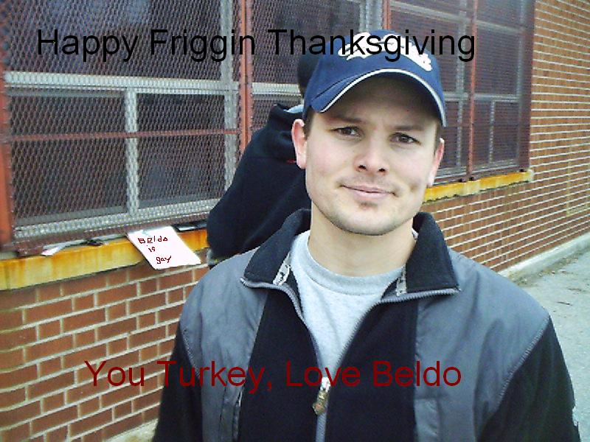
Beldo Spreading Holiday Cheer

Slide 11
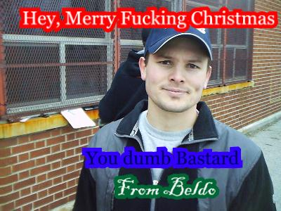
Happy Holidays from Beldo!

Slide 12
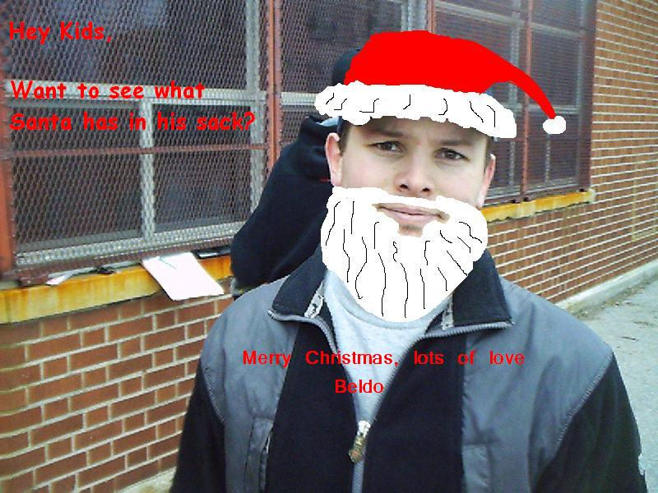
Beldo as Santa…

